Slide 1
Quiz Management System
Course Code: CSC 2209
Object Oriented Analysis and Design
Dept. of Computer Science
Faculty of Science and Technology
ID | Name
20-43710-2 | 1. Md. Ashraful Islam Emad
20-42970-1 | 2. Fahim Mahmud Bhuiyan
20-43248-1 | 3. Muntaqa Maliyat

Slide 2
Outline
Introduction
Problem Statement(Objectives)
Analysis of the System
Design
Conclusion(Future work)
References

Slide 3
Introduction
The Quiz Management system allows students to take quizzes online, provided by their respective teachers without the need to be present physically which acts as the main objective for creating this application, due to the pandemic. Overcoming manual errors, saving time and making a computerized system which is both efficient and easy to use is the goal. The process starts off with the teacher logging in and then he/she uploads the quiz making it accessible to the students. The teacher has the authority to modify or add any question, alter the scores each question carries, limit the time within which the students have to submit the quiz and while entering the question he/she will be able to select the right answer for the questions. In their assigned time, the students log in to the system, take the quiz when the teacher starts it and then submit it, failing to submit on time will provoke auto submission of the quiz. The application will be able to evaluate each question by comparing its correct answer. Online quiz management system can be implemented in colleges, universities or at home to check the preparation of students and revise contents of different courses.

Slide 4
Problem Statement
Due to the epidemic, everyone is performing their duties from their own position, so this application is being created for the convenience of the students. Through this application, he/she will be able to participate in the online exam even if he/she is not present in the classroom, which will be controlled by his/her teacher. In addition, this application reduces the waste of time as well as the answer sheet can be checked and selected accurately.
From the above discussion, we can say that the problem of “Quiz Management System” is important to consider.

Slide 5
Objectives
Proposed Solution
To deal with the problem we are going to propose some solutions which is given below:
The project is to be focused on developing a “Quiz Management System” to ensure the effectiveness of taking online exam.
Quiz can be done online without the need of paper or physical presence anymore. It is also helping the users to ensure the best use of time.
Teachers will get easier way to check answers of the students. Students can also join the exam from anywhere.

Slide 6
Analysis of the System
Functional Requirements: Quiz Management System provides an online interface to the users where they can log in and give or take quizzes online. The administrator concerned with the log in issue. Teachers and students can use the system. Provide a platform for the students and teachers to ensure online based exam.
Non Functional Requirements: Quiz Management proposed system is very efficient. Now a student can take a quiz from anywhere. The person can even get the exam details. They don’t need to go outside and have to give exam in the classroom. So, because of easy access they can complete their exam process staying anywhere with just one device and internet connection. Sometimes students might face some issues because of their poor network connection. Besides this sometimes server may show down because of too much traffic in the system. But we can say this issue can take into the consideration. As the issue is worth to solve so this is a good side of this project. Also, for the teachers, this project is helpful because it’s easy to control. This kind of project might be available in the market but we can assure that we’ve got the best solution for the problem which can be solved easily.

Slide 7
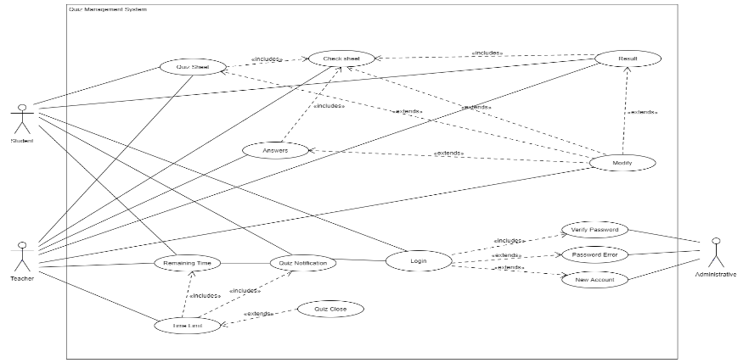
Design
Use Case Diagram

Slide 8
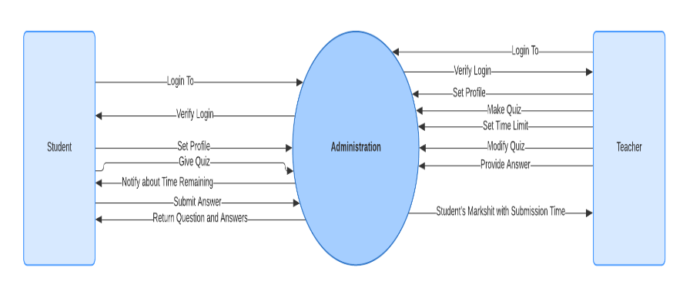
Data Flow Diagram

Slide 9
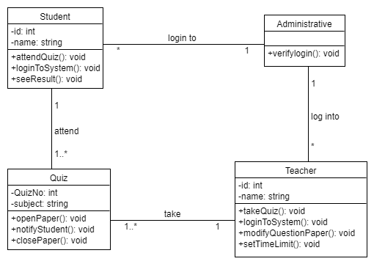
Class Diagram

Slide 10
CRC Card
Class: | Student
Description: | Keep track of Student's info and gives the user ability to log in and give quiz.
Responsibilities | Collaborators:
Set Profile | Student’s Profile
Give Quiz
View Remaining Time | Time
Submit Answer Script
View Result
Class: | Teacher
Description: | Keep track of Teacher's info and gives the user ability to log in, make quiz, set time limit, modify quiz and enter answer for auto check.
Responsibilities | Collaborators:
Set Profile | Teacher’s Profile
Make Quiz
Set Time limit | Date and Time
Modify Quiz
Set Answers

Slide 11
Class: | Administrator
Description: | Keep track of Student and Teacher’s login and verify their password.
Responsibilities | Collaborators:
Verifying Student and Teacher’s password
Notify Remaining Time to Student | Date and Time
Return question and answers | Auto Check

Slide 12
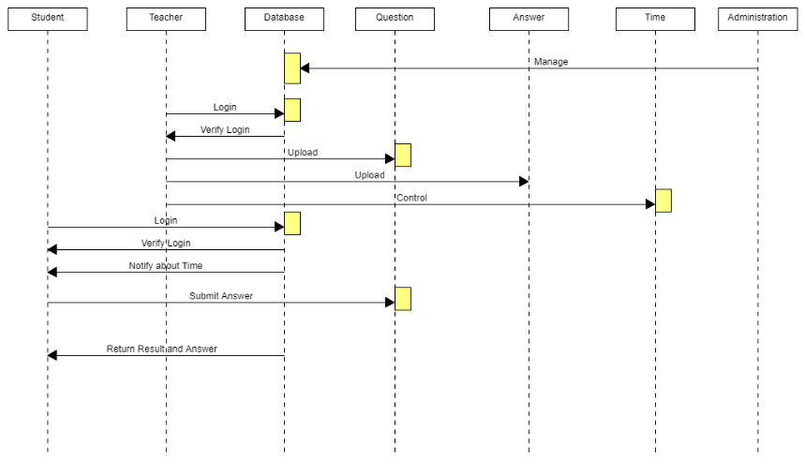
Sequence Diagram

Slide 13
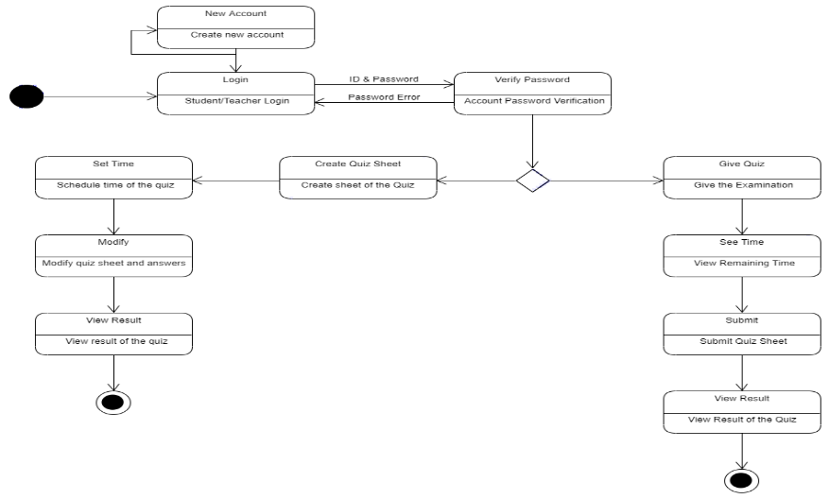
State Chart Diagram

Slide 14
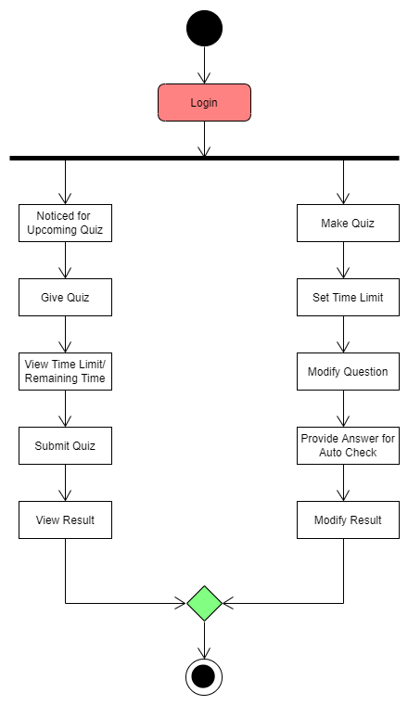
Activity Diagram

Slide 15
Conclusion
The online quiz management project aims to improve university exam procedures by providing students and teachers with efficient, user-friendly, and accessible online quizzes. The existing system, which used paper as the backend, was not efficient, time-consuming, or physically present. The proposed system uses access as the backend, improving basic requirements and making it more accessible. Students can take quizzes from anywhere, access exam details, and complete their exam process with just one device and internet connection. However, poor network connections and excessive traffic may cause issues. This MCQ-based quiz system is ideal for educational institutions but can also be customized for other examinations like job interviews and quiz contests. The project is innovative, interesting, and distinct from similar projects in the market.

Slide 16
References
[1] Arief, H., 2012, September. Designing And Building An Adaptive Online Quiz System As Extension Of Content Management System. In proceedings intl conf information system business competitiveness.
[2] Quora. (2019). What difficulties will students face due to online exams? [online] Available at: https://www.quora.com/What-difficulties-will-students-face-due-to-online-exams [Accessed 3 Dec. 2021].
[3] Education Technology for Digital Assessments, Exams, Admissions and trends. (n.d.). Top 4 Challenges to manage Online Exam Process. [online] Available at: https://blog.epravesh.com/top-4-challenges-manage-online-exam-process/.
[4] TECHCOMMUNITY.MICROSOFT.COM. (n.d.). ‘Sorry, something went wrong’ error, had to switch to Google Forms due to this problem. [online] Available at: https://techcommunity.microsoft.com/t5/microsoft-forms/quot-sorry-something-went-wrong-quot-error-had-to-switch-to/m-p/293305 [Accessed 3 Dec. 2021].
[5] Takata, S. and Yamagishi, Y., 2015, October. Mobile-based Quiz Rally Management System aimed at learning the Region. In E-Learn: World Conference on E-Learning in Corporate, Government, Healthcare, and Higher Education (pp. 1189-1193). Association for the Advancement of Computing in Education (AACE).
[6] TECHCOMMUNITY.MICROSOFT.COM. (n.d.). Microsoft Forms not working on chrome. [online] Available at: https://techcommunity.microsoft.com/t5/microsoft-forms/microsoft-forms-not-working-on-chrome/m-p/1926704 [Accessed 3 Dec. 2021].
[7] login.microsoftonline.com. (n.d.). Microsoft Forms is not working for me on both Safari and Chrome [online] Available at: https://answers.microsoft.com/en-us/msoffice/forum/all/microsoft-forms-is-not-working-for-me-on-both/fd281d53-b890-47f9-af3d-e558cac7fd97 [Accessed 3 Dec. 2021].
[8] Alphr. (n.d.). Google Forms vs. Microsoft Forms. [online] Available at: https://www.alphr.com/google-forms-vs-microsoft-forms/.

Slide 17
[9] Abood, M.S., Ismail, M. and Nordin, R., 2016, November. A quiz management system based on P2P near-field communication on Android platform for smart class environments. In 2016 international conference on advances in electrical, electronic and systems engineering (ICAEES) (pp. 83-88). IEEE.
[10] Markié, M., 2017, September. Evaluation of quiz using a statistical calculation in Learning Management System. In 2017 25th International Conference on Software, Telecommunications and Computer Networks (SoftCOM) (pp. 1-5). IEEE.
[11] Nur, N., 2018. Web Based Quiz System (Doctoral dissertation, United International University).
[12] Ismiati, M.B. and Hermawan, L., 2020. Online Quiz Application for Informatics and Information System Students (Task Portal Development). Journal of Computer Science and Engineering (JCSE), 1(1), pp.30-39.
[13] Rachel, V. and Parthasarathy, M., 2017. Moodle Online Test (Quiz) for Computer Science Students of Higher Educational Institute. International Journal of Computer Science and Engineering, 4(6), p.14.
[14] Ijtihadie, R.M., Chisaki, Y., Usagawa, T., Cahyo, H.B. and Affandi, A., 2010, November. Offline web application and quiz synchronization for e-learning activity for mobile browser. In TENCON 2010-2010 IEEE Region 10 Conference (pp. 2402-2405). IEEE.
[15] Alessio, H.M., Malay, N., Maurer, K., Bailer, A.J. and Rubin, B., 2017. Examining the effect of proctoring on online test scores. Online Learning, 21(1), pp.146-161.
[16] Jia, J. and He, Y., 2021. The design, implementation and pilot application of an intelligent online proctoring system for online exams. Interactive Technology and Smart Education, 19(1), pp.112-120.

Slide 18


